Slide 1

Shri Vaishnav Vidhyapeeth Vishwavidayalaya
Shri Vaishnav Institute of Information Technology
Indore-Ujjain Road, Indore-453111
Academic Session July - Dec 2024
Laboratory Manual
Course Name: - Introduction To Core Java Course Code: - BTIT307N
Submitted To:
Prof. Ankit Upadhyay
Assistant Professor, SVIIT, SVVV Indore
Submitted By: sonal jamliya Enrollment No:
23100BTAIMLM14566

Slide 2

Shri Vaishnav Vidhyapeeth Vishwavidayalaya
Shri Vaishnav Institute of Information Technology
Indore-Ujjain Road, Indore-453111
INDEX
S. no | Date of Experiment | Name of Experiment | Page No. | Date of Submission | Remarks
1 | 30-07-2024 | Write a program to display "Welcome to Programming!" and calculate the product of two numbers entered by the user. | 3
2 | 13-08-2024 | Write a program to demonstrate the use of all basic data types. | 4-5
3 | 27-08-2024 | Write a program to store and display the ages of 7 family members using an array. | 6-7
4 | 02-09-2024 | Write a program to check if a number entered by the user is divisible by 5. | 8
5 | 09-09-2024 | Write a program to check whether a number entered by the user is positive, negative, or zero. | 9
6 | 23-09-2024 | Write a program to classify a person based on their age. | 10-11
7 | 30-09-2024 | Write a program that displays the number of days in that month using a switch case. | 12-13
8 | 14-10-2024 | Write a program to print the first 10 Fibonacci numbers using a for loop. | 14
9 | 21-10-2024 | Write a program to: a) Use a while loop to find the factorial of a number entered by the user. | 15-16

Slide 3
Shri Vaishnav Vidhyapeeth Vishwavidayalaya
Shri Vaishnav Institute of Information Technology
Indore-Ujjain Road, Indore-453111
 |  | b) Use a do-while loop to reverse a number entered by the user and display the result.
10 | 11-11-2024 | Write a program to create objects of Vehicle and Car and call their start methods. | 17

Slide 4
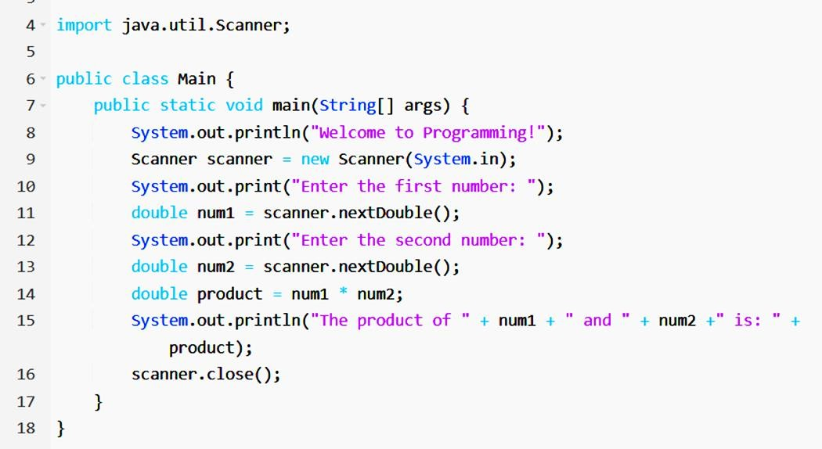
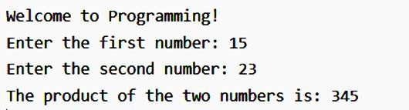
Shri Vaishnav Vidhyapeeth Vishwavidayalaya
Shri Vaishnav Institute of Information Technology
Indore-Ujjain Road, Indore-453111
Q1. Write a program to display "Welcome to Programming!" and calculate the product of two numbers entered by the user.
Solution:
Output:

Slide 5
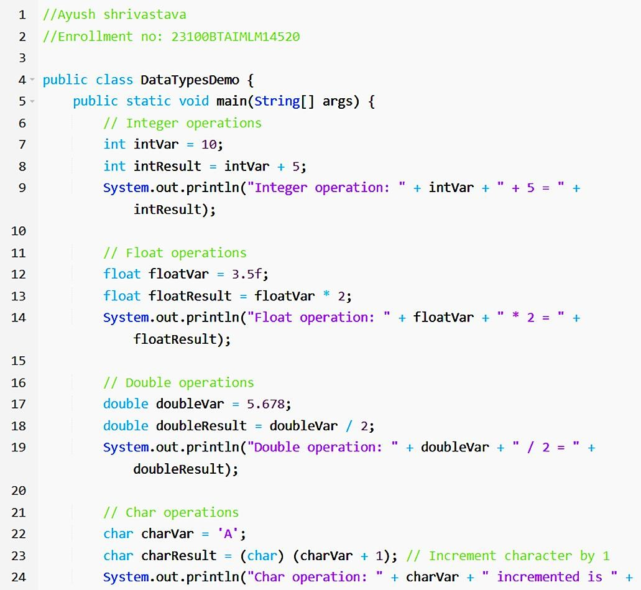
Shri Vaishnav Vidhyapeeth Vishwavidayalaya
Shri Vaishnav Institute of Information Technology
Indore-Ujjain Road, Indore-453111
Q2. Create a program to demonstrate the use of all basic data types (int, float, double, char, and Boolean) by performing simple operations with variables of each type.
Solution:

Slide 6
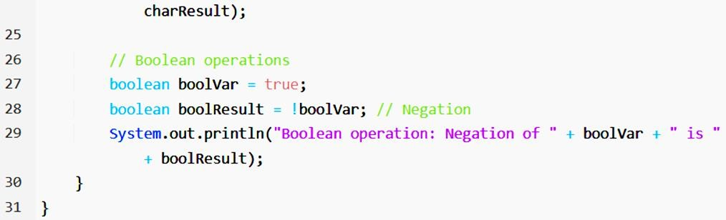
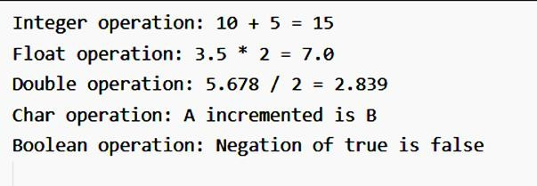
Shri Vaishnav Vidhyapeeth Vishwavidayalaya
Shri Vaishnav Institute of Information Technology
Indore-Ujjain Road, Indore-453111
Output:

Slide 7
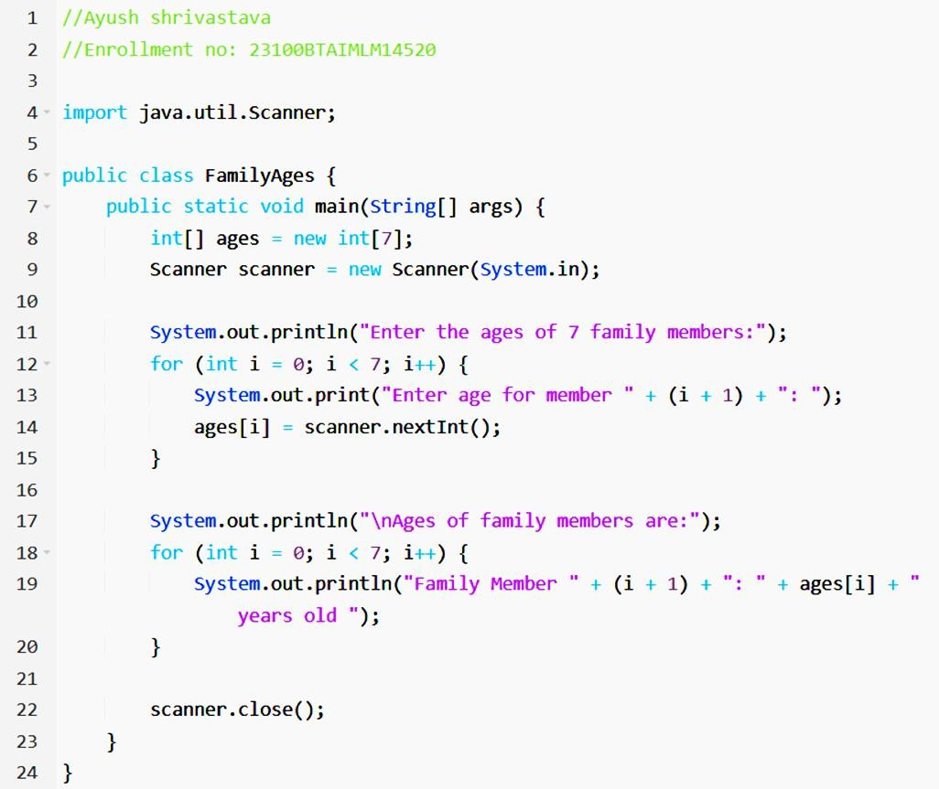
Shri Vaishnav Vidhyapeeth Vishwavidayalaya
Shri Vaishnav Institute of Information Technology
Indore-Ujjain Road, Indore-453111
Q3. Write a program to store and display the ages of 7 family members using an array.
Solution:

Slide 8
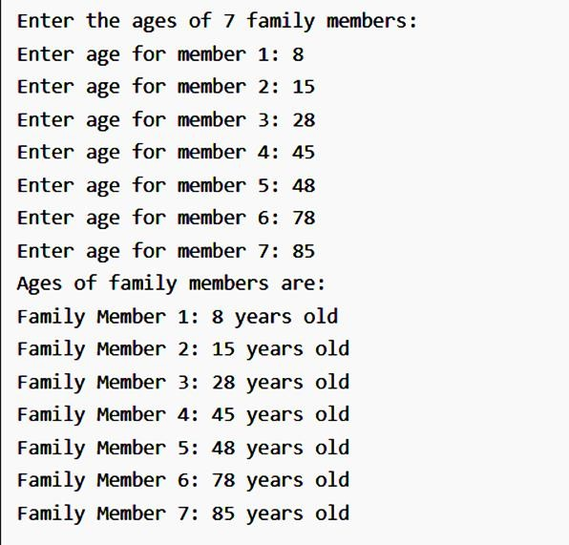
Shri Vaishnav Vidhyapeeth Vishwavidayalaya
Shri Vaishnav Institute of Information Technology
Indore-Ujjain Road, Indore-453111
Output:

Slide 9
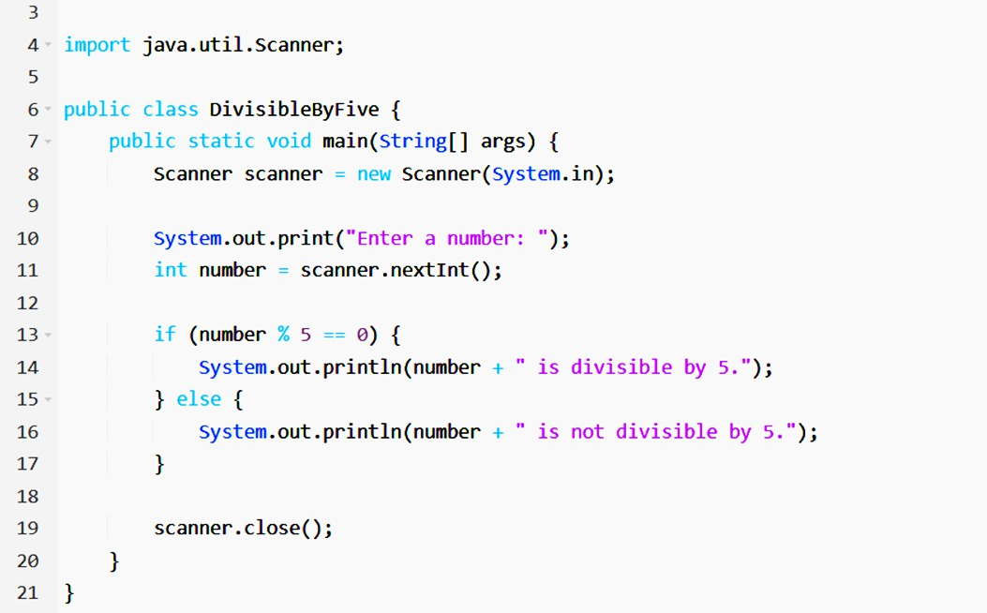
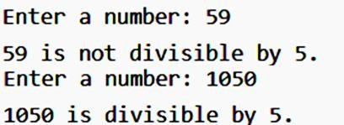
Shri Vaishnav Vidhyapeeth Vishwavidayalaya
Shri Vaishnav Institute of Information Technology
Indore-Ujjain Road, Indore-453111
Q4. Write a program to check if a number entered by the user is divisible by 5.
Solution:
Output:

Slide 10
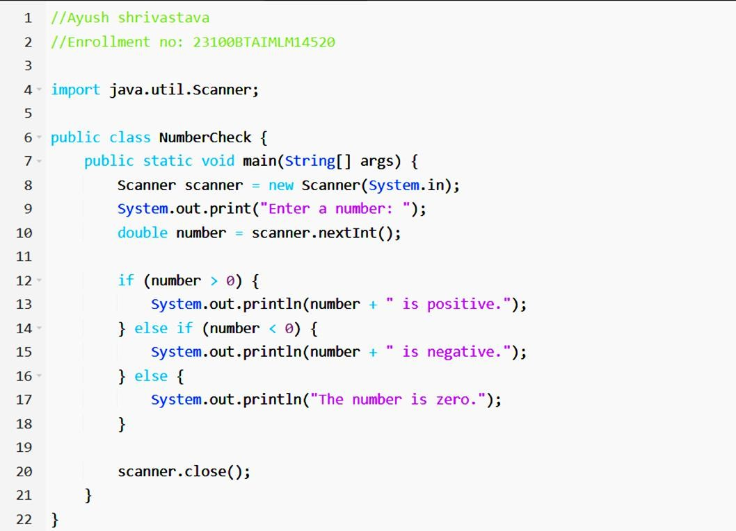
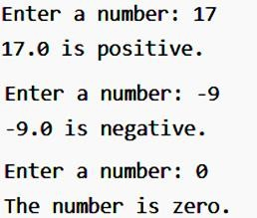
Shri Vaishnav Vidhyapeeth Vishwavidayalaya
Shri Vaishnav Institute of Information Technology
Indore-Ujjain Road, Indore-453111
Q5. Write a program to check whether a number entered by the user is positive, negative, or zero.
Solution:
Output:

Slide 11
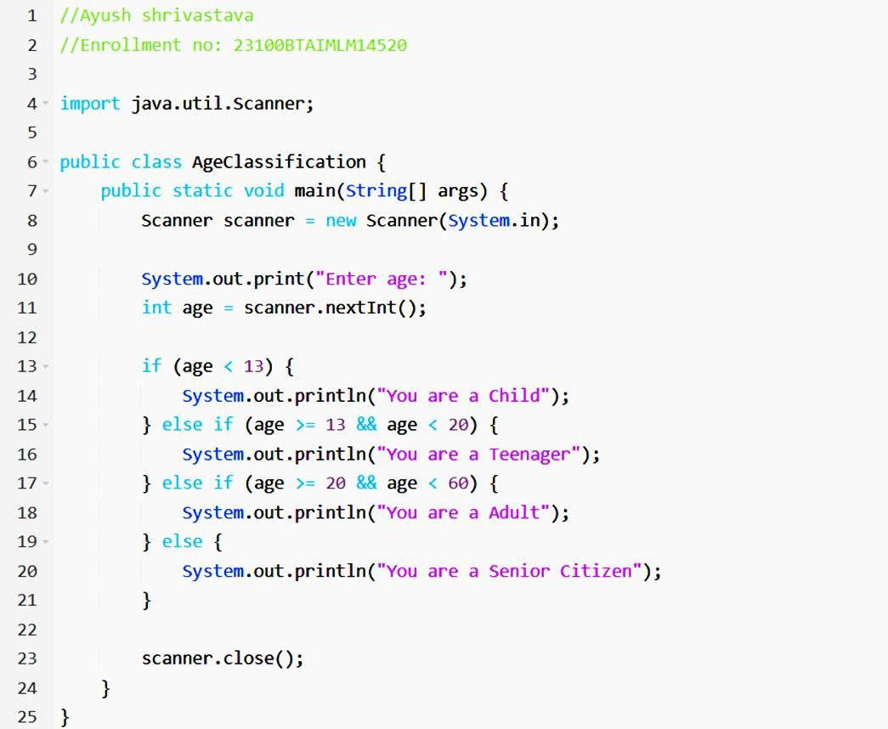
Shri Vaishnav Vidhyapeeth Vishwavidayalaya
Shri Vaishnav Institute of Information Technology
Indore-Ujjain Road, Indore-453111
Q6. Write a program to classify a person based on their age using the following criteria: Age < 13: Child, 13 <= Age < 20: Teenager, 20 <= Age < 60: Adult, Age
>= 60: Senior Citizen.
Solution:

Slide 12
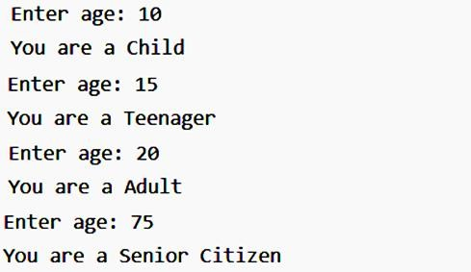
Shri Vaishnav Vidhyapeeth Vishwavidayalaya
Shri Vaishnav Institute of Information Technology
Indore-Ujjain Road, Indore-453111
Output:

Slide 13
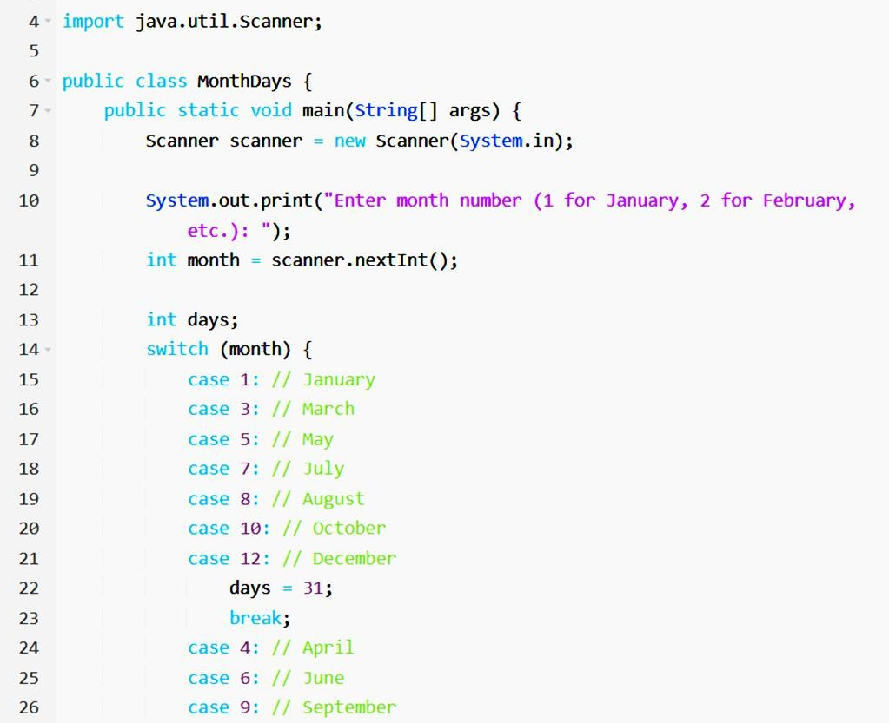
Shri Vaishnav Vidhyapeeth Vishwavidayalaya
Shri Vaishnav Institute of Information Technology
Indore-Ujjain Road, Indore-453111
Q7. Write a program that takes a month number (1 for January, 2 for February, etc.) and displays the number of days in that month using a switch case.
Solution:

Slide 14
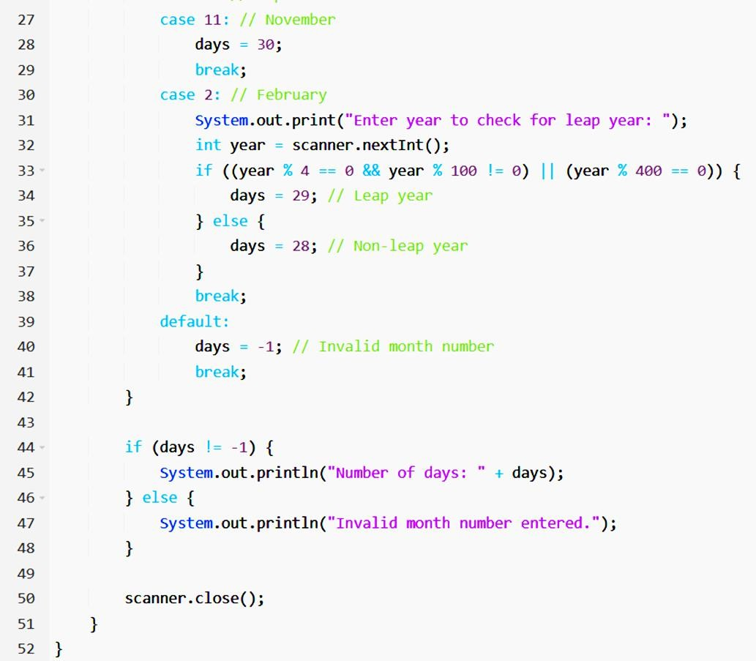
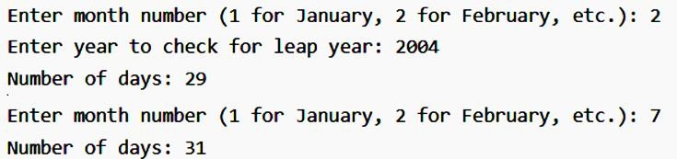
Shri Vaishnav Vidhyapeeth Vishwavidayalaya
Shri Vaishnav Institute of Information Technology
Indore-Ujjain Road, Indore-453111
Output:

Slide 15
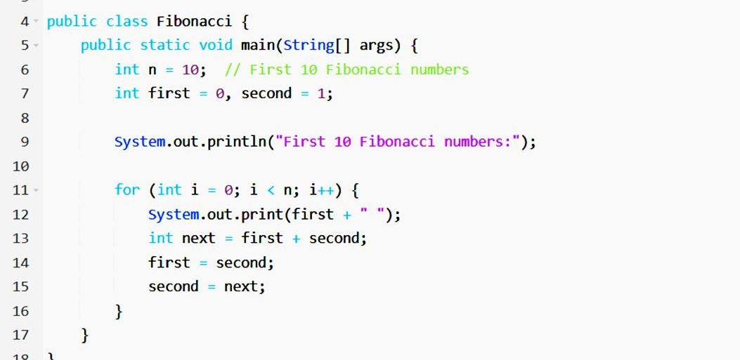

Shri Vaishnav Vidhyapeeth Vishwavidayalaya
Shri Vaishnav Institute of Information Technology
Indore-Ujjain Road, Indore-453111
Q8. Write a program to print the first 10 Fibonacci numbers using a for loop.
Solution:
Output:

Slide 16
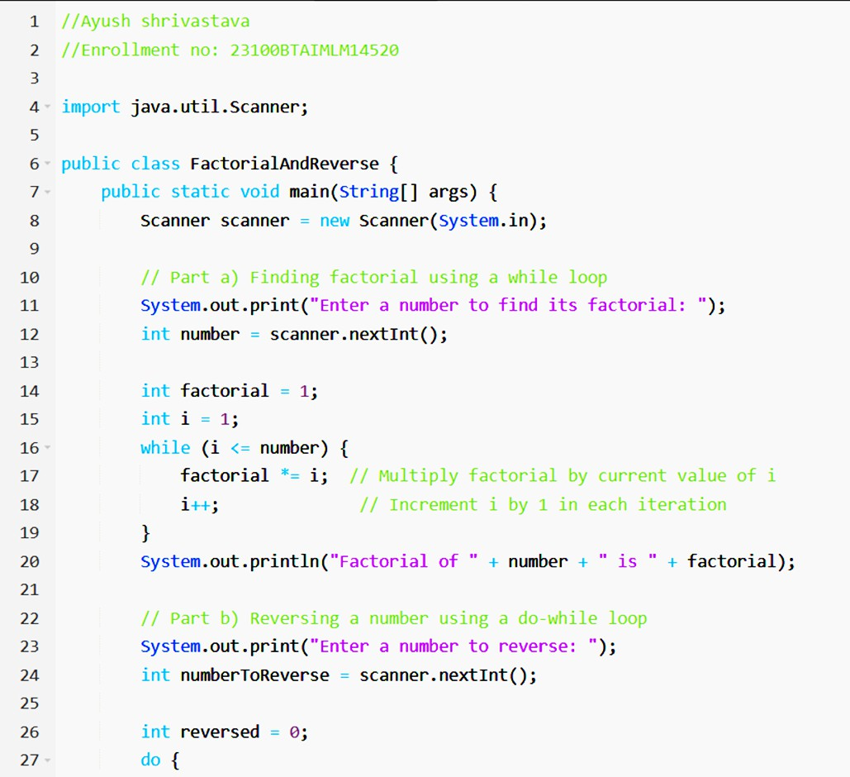
Shri Vaishnav Vidhyapeeth Vishwavidayalaya
Shri Vaishnav Institute of Information Technology
Indore-Ujjain Road, Indore-453111
Q9. a) Use a while loop to find the factorial of a number entered by the user.
b) Use a do-while loop to reverse a number entered by the user and display the result.
Solution:

Slide 17
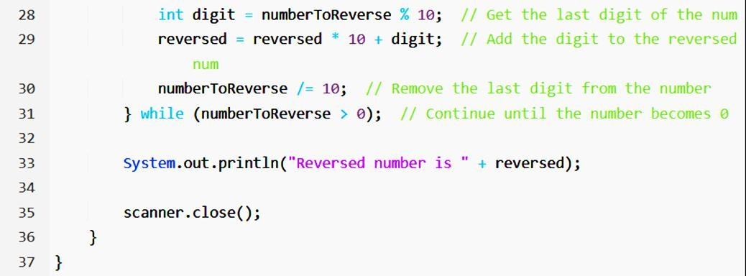
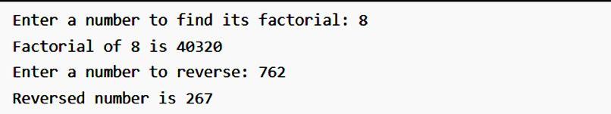
Shri Vaishnav Vidhyapeeth Vishwavidayalaya
Shri Vaishnav Institute of Information Technology
Indore-Ujjain Road, Indore-453111
Output:

Slide 18
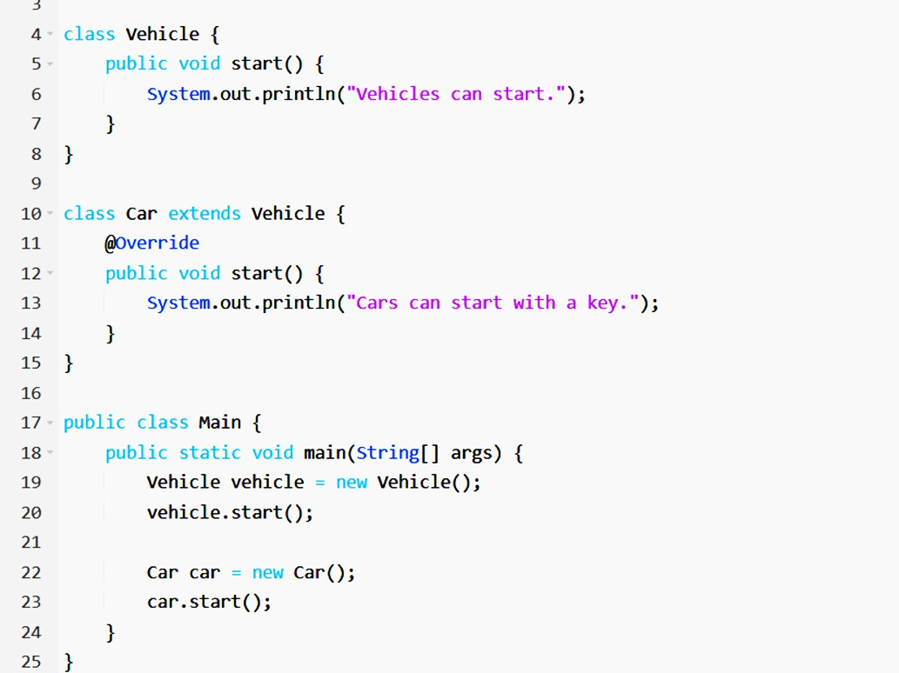

Shri Vaishnav Vidhyapeeth Vishwavidayalaya
Shri Vaishnav Institute of Information Technology
Indore-Ujjain Road, Indore-453111
Q10. Create a class Vehicle with a method start those prints "Vehicles can start." Create a subclass Car that overrides the start method to print "Cars can start with a key." Write a program to create objects of Vehicle and Car and call their start methods.
Solution:
Output:

